Slide 1


HR Management System on the Cloud
This project aims to develop a comprehensive HR management system on the cloud. The system will streamline various HR processes, improve efficiency, and enhance employee experience.
HARSHAVARDHANA JOSHI BVS
192210201

Slide 2

Key HR Processes to Manage
1
Recruitment
2
Benefits Administration
Automating job postings, candidate screening, and interview scheduling, while improving communication and engagement with applicants.
Managing employee benefits enrollment, claims processing, and reporting, simplifying benefits management for both employees and HR.
3
Performance Management
4
Training & Development
Facilitating performance reviews, goal setting, and feedback, providing a structured system for performance evaluation and development.
Creating and delivering online training programs, tracking employee progress, and facilitating skill development within the organization.

Slide 3
Selecting the Cloud Platform
AWS
Google Cloud Platform
Microsoft Azure
Amazon Web Services (AWS) offers a wide range of cloud services, including compute, storage, networking, and databases. AWS is known for its scalability, security, and global infrastructure.
Google Cloud Platform (GCP) provides a comprehensive set of cloud services, including data analytics, machine learning, and artificial intelligence. GCP is known for its innovation and developer-friendly tools.
Microsoft Azure offers a broad range of cloud services, including virtual machines, storage, databases, and analytics. Azure is known for its integration with Microsoft products and its hybrid cloud capabilities.

Slide 4


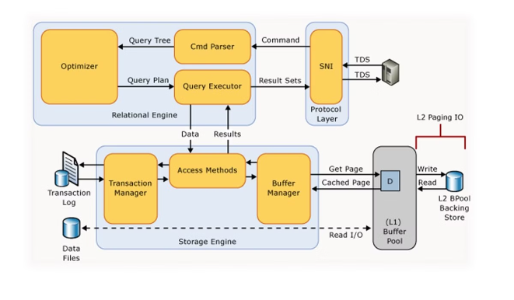



Designing the System Architecture
User Interface
A user-friendly web application that allows HR professionals to manage various HR functions.
API Gateway
A secure interface that allows different applications and services to interact with the HR system.
Microservices
Modular components responsible for specific HR functionalities, such as recruitment, benefits, or payroll.
Database
A scalable and secure database to store and manage all HR data, including employee records, benefits information, and performance reviews.

Slide 5

Developing the Application
Front-end Development
1
Building the user interface using technologies like HTML, CSS, and JavaScript, ensuring a responsive and user-friendly experience.
2
Back-end Development
Creating the server-side logic using languages like Python, Java, or Node.js, and connecting the application to the database and other cloud services.
API Development
3
Developing secure APIs to enable communication between the user interface, microservices, and external systems.
4
Testing and Deployment
Thoroughly testing the application to ensure functionality, security, and performance before deploying it to the cloud platform.

Slide 6

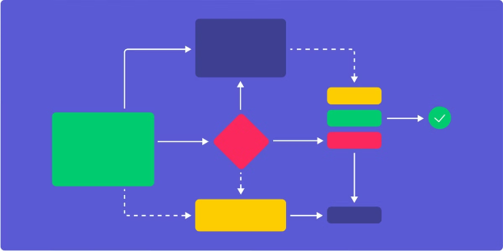
Integrating HR Workflows
Recruitment
Automating candidate screening, interview scheduling, and onboarding processes.
Benefits Administration
Integrating with third-party benefits providers to streamline enrollment, claims processing, and reporting.
Performance Management
Connecting performance reviews to employee development plans, promoting continuous improvement and growth.
Training & Development
Integrating with learning management systems to deliver online training, track progress, and measure impact.

Slide 7


Ensuring Scalability and Security
Scalability
Security
The system must be able to handle increasing workloads and user traffic as the organization grows.
Implementing strong authentication, authorization, and data encryption measures to protect sensitive HR information.
Compliance
Disaster Recovery
Adhering to relevant privacy regulations and industry standards to ensure responsible data handling.
Creating backups and redundancy plans to ensure system availability in case of unexpected outages or disasters.

Slide 8






Deploying and Maintaining the System
Deployment
Monitoring
Deploying the application to the chosen cloud platform, configuring server settings, and ensuring seamless integration with existing systems.
Continuously monitoring system performance, identifying potential issues, and proactively addressing any problems to ensure optimal functionality.
Security Updates
Support
Regularly patching and updating the system to protect against security vulnerabilities and maintain compliance with industry standards.
Providing ongoing support to HR users, troubleshooting issues, and ensuring the system meets their evolving needs.

Slide 9

Deploying and Maintaining the System
In this final step, we'll cover the key considerations for deploying the HR management system to the cloud and maintaining it over time. This includes setting up the production environment, automating deployments, and establishing ongoing monitoring and support processes.
Production Deployment
Automation
Monitoring & Support
Implement CI/CD pipelines to automate deployments and updates.
Create the cloud infrastructure and configure the application for production use.
Set up monitoring, alerting, and support processes to maintain the system.
Conclusion
By following these deployment and maintenance best practices, your organization can successfully operate the HR management system on the cloud. This will enable ongoing optimization and evolution of your HR processes and employee experiences.

Slide 10

Thank You

